Slide 1

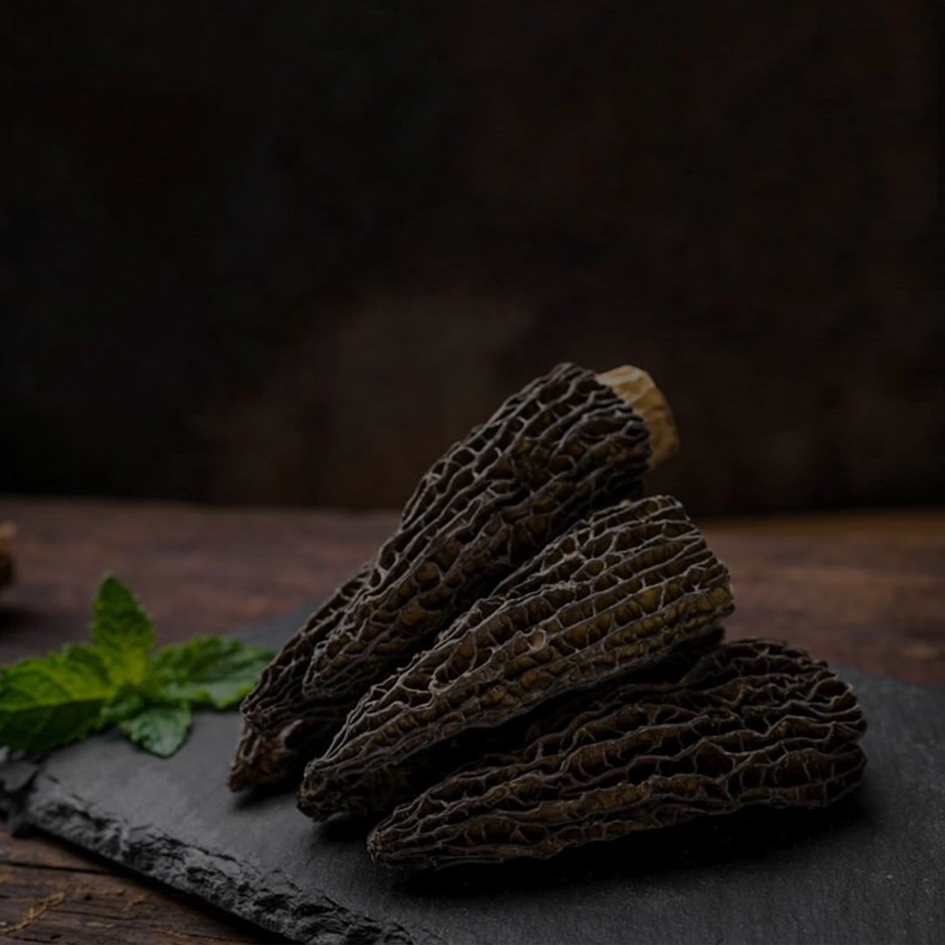
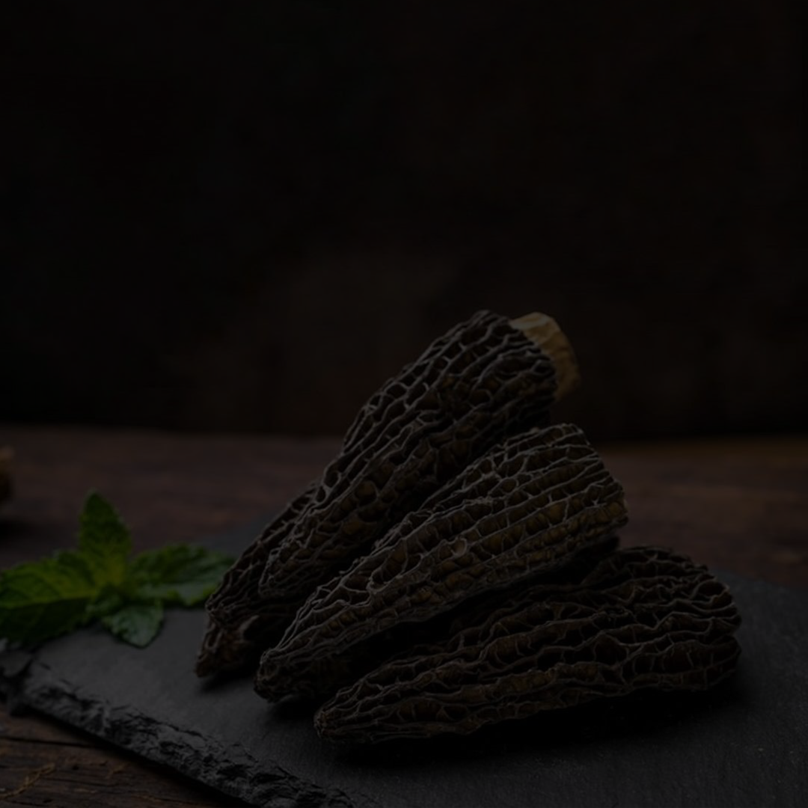



A
Size |  | Thickness |  | Price
1-4 cm |  | Thick |  | $ 282
1-8 cm |  | Thick |  | $ 265
8-12 cm |  | Thick |  | $ 315
Up to 2% White Spots per bag Up to 3% Damage per bag
B
C
Size |  | Thickness |  | Price
1-4 cm |  | Median |  | $ 182
1-8 cm |  | Median |  | $ 199
8-12 cm |  | Median |  | $ 215
Up to 6% White Spots per bag Up to 4% Damage per bag
Size |  | Thickness |  | Price
1-8 cm |  | Thin |  | $ 149
Up to 6% White Spots per bag Up to 5% Damage per bag

Slide 2
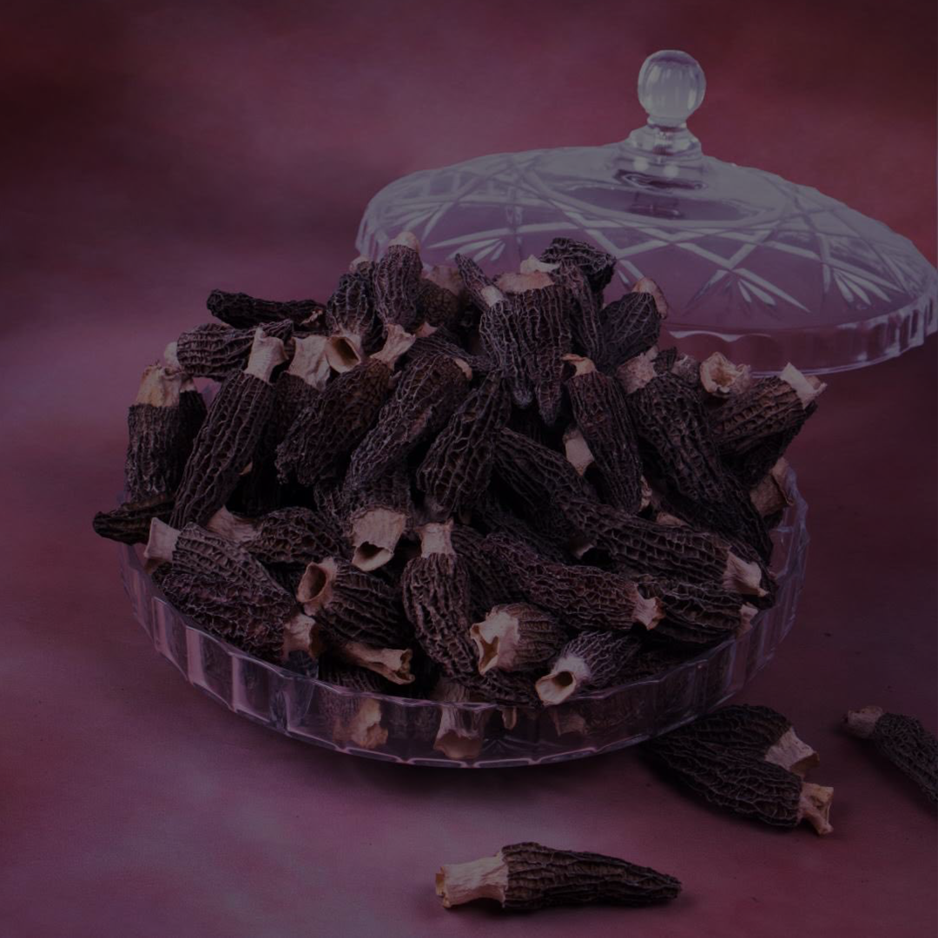
A
Size |  | Thickness |  | Price
1-4 cm |  | Thick |  | $ 282
1-8 cm |  | Thick |  | $ 265
8-12 cm |  | Thick |  | $ 315
Up to 2% White Spots per bag Up to 3% Damage per bag
B
C
Size |  | Thickness |  | Price
1-4 cm |  | Median |  | $ 182
1-8 cm |  | Median |  | $ 199
8-12 cm |  | Median |  | $ 215
Up to 6% White Spots per bag Up to 4% Damage per bag
Size |  | Thickness |  | Price
1-8 cm |  | Thin |  | $ 149
Up to 6% White Spots per bag Up to 5% Damage per bag

Slide 3
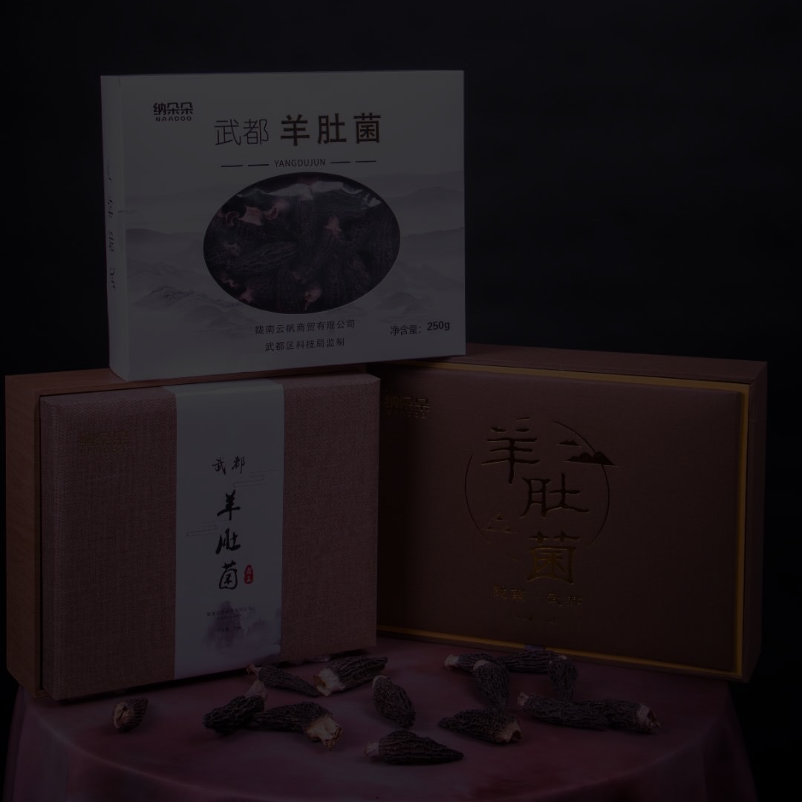
A
Size |  | Thickness |  | Price
1-4 cm |  | Thick |  | $ 282
1-8 cm |  | Thick |  | $ 265
8-12 cm |  | Thick |  | $ 315
Up to 2% White Spots per bag Up to 3% Damage per bag
B
C
Size |  | Thickness |  | Price
1-4 cm |  | Median |  | $ 182
1-8 cm |  | Median |  | $ 199
8-12 cm |  | Median |  | $ 215
Up to 6% White Spots per bag Up to 4% Damage per bag
Size |  | Thickness |  | Price
1-8 cm |  | Thin |  | $ 149
Up to 6% White Spots per bag Up to 5% Damage per bag

Slide 4
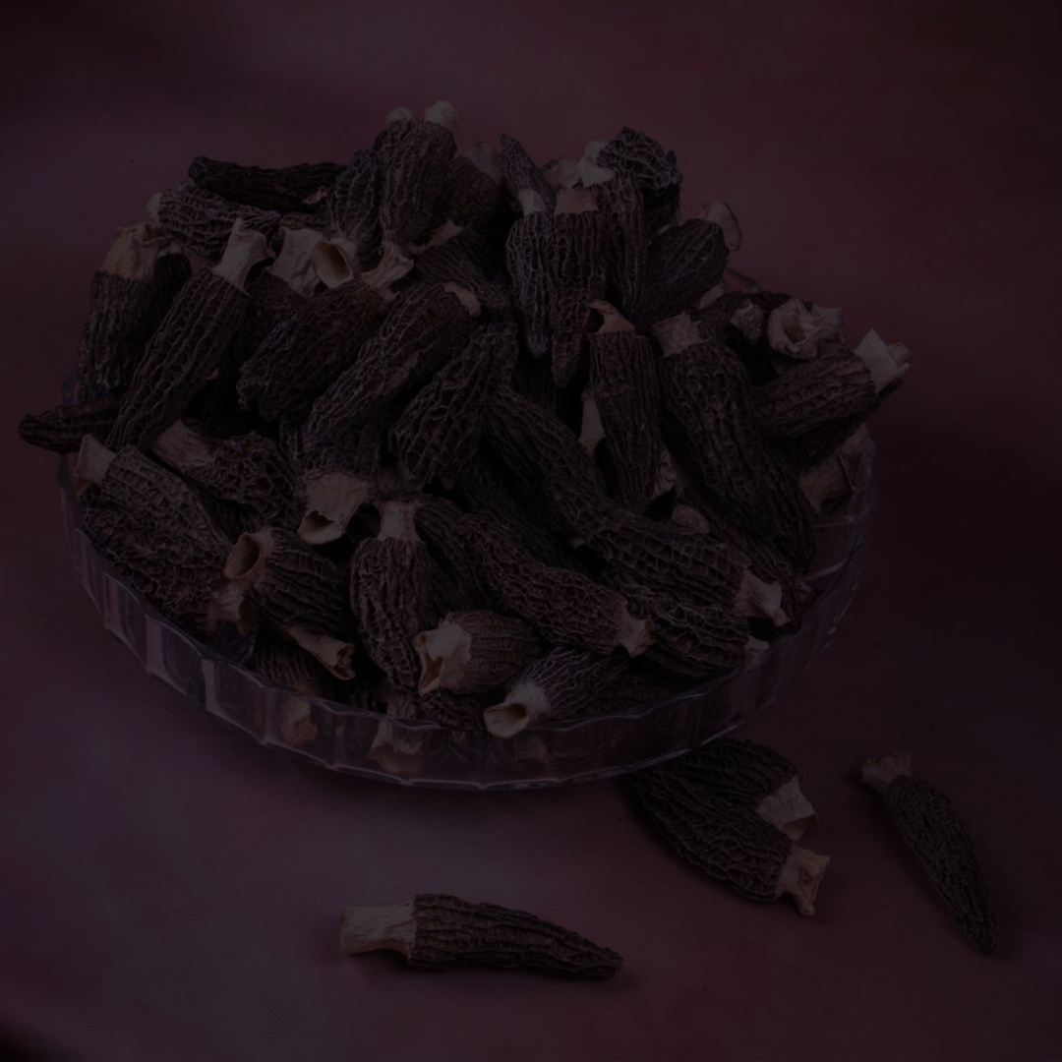
A
Size |  | Thickness |  | Price
1-4 cm |  | Thick |  | $ 282
1-8 cm |  | Thick |  | $ 265
8-12 cm |  | Thick |  | $ 315
Up to 2% White Spots per bag Up to 3% Damage per bag
B
C
Size |  | Thickness |  | Price
1-4 cm |  | Median |  | $ 182
1-8 cm |  | Median |  | $ 199
8-12 cm |  | Median |  | $ 215
Up to 6% White Spots per bag Up to 4% Damage per bag
Size |  | Thickness |  | Price
1-8 cm |  | Thin |  | $ 149
Up to 6% White Spots per bag Up to 5% Damage per bag

Slide 5

A
Size |  | Thickness |  | Price
1-4 cm |  | Thick |  | $ 282
1-8 cm |  | Thick |  | $ 265
8-12 cm |  | Thick |  | $ 315
Up to 2% White Spots per bag Up to 3% Damage per bag
B
C
Size |  | Thickness |  | Price
1-4 cm |  | Median |  | $ 182
1-8 cm |  | Median |  | $ 199
8-12 cm |  | Median |  | $ 215
Up to 6% White Spots per bag Up to 4% Damage per bag
Size |  | Thickness |  | Price
1-8 cm |  | Thin |  | $ 149
Up to 6% White Spots per bag Up to 5% Damage per bag

